Slide 1
ASSESSMENT OF FITNESS AND HEALTH
Dr. Santosh Dobhal
Dept. Of Cardiovascular & RespiratoryPhysiotherapy
MGM Institute Of Physiotherapy
Chh. Sambhajinagar

Slide 2
CONTENTS
Screening Of Risk Factors
Body Composition
Physical Fitness
Physical Activity Readiness Questionnaire
Screening Of Health And Fitness In Childhood, Adulthood And Geriatric Group
Principles & Components Of Exercise Prescription For Healthy

Slide 3
Screening Of Risk Factors
Numerous physiologic, psychologic, and metabolic health/fitness benefits result from participation in regular physical activity.
Although there is risk of acute musculoskeletal injury during exercise, the major concern is the increased risk of sudden cardiac death and myocardial infarction that is sometimes associated with vigorous physical exertion.

Slide 4
Screening Of Risk Factors
Identification of individuals with medical contraindications for exclusion from exercise programs until those conditions have been abated or are under control
Recognition of persons with clinically significant disease(s) or conditions who should participate in a medically supervised exercise program

Slide 5
Screening Of Risk Factors
Detection of individuals at increased risk for disease because of age, symptoms, and/or risk factors who should undergo a medical evaluation and exercise testing before initiating an exercise program or increasing the frequency, intensity, or duration of their current program
Recognition of special needs of individuals that may affect exercise testing and programming

Slide 6
A major public health goal is to increase individual participation in regular, moderate-to-vigorous physical activity

Slide 7
Pursuit of this goal must include a process for identifying individuals at increased risk for adverse exercise-related events.
At the same time, the risk stratification process should not present a significant barrier to participation. This chapter presents guidelines for (a) evaluating an individual's risk for adverse exercise-related events and

Slide 8
(b) making appropriate recommendations regarding the initiation, continuation, or progression of an individual's physical activity program to reduce the potential occurrence of these types of catastrophic events.

Slide 9
BODY COMPOSITION

Slide 10
INTRODUCTION
Body composition is a key component of individual’s health and physical fitness profile.
Reflects the balance of physical activity and nutritional habits.
Body composition can be expressed as a relative percentage of body mass that is fat and fat free tissue.

Slide 11
Why there is a Need???
Important part of Health Screening
Measurements are used for :
Risk assessment.
Formulating nutritional recommendations.
Individualization of the exercise prescription.
Evaluation of the efficacy of intervention.

Slide 12
Models of body composition

Slide 13
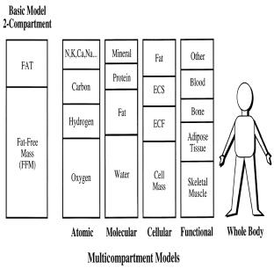
Models of body composition

Slide 14
Molecular model
The classical two-component (2-C) model consisting of
Fat mass (FM)
Fat-free mass (FFM)

Slide 15
Concern of the validity of the two component model in subjects who vary in age, gender and race led to the development of molecular multi-component models.

Slide 17
Cellular model
The human body cellular model consists from three main components
Cells
Extracellular fluids
Extracellular solids

Slide 18
Most accepted cellular model
BW = FM + extracellular fluids +extracellular solids + BCM (body cell mass )

Slide 19
Tissue system model
Components are
Adipose tissue
Skeletal muscle
Bone
Visceral organs
Brain

Slide 20
Adipose tissue is further divided into
Subcutaneous
Visceral
Yellow marrow
Interstitial fat components

Slide 21
Anthropometrical methods have been main methods for assessing body composition according to tissue-system model.
Newer techniques – CT , MRI.

Slide 22
Theoritical Methods

Slide 23
Theoritical Methods
Direct
Indirect
Doubly indirect
Property based
Component based

Slide 24
Indirect method
Hydrodensito-metry
MRI ,CT scans
DEXA
Doubly indirect
Skinfold analysis
Bioelectrical impedance method
Plythesmography

Slide 25
Laboratory Methods

Slide 26
Laboratory Methods
Used as reference method in clinical and research methods
Hydrostatic Weighing
Air displacement plethysmography
Dual energy x ray absorptiometry
CT and MRI

Slide 27
Hydrostatic Weighing
Also known as underwater weighing (UWW).
Gold standard method based on 2-C model.
Based on Archimedes principle :When an body is submerged underwater , it looses its weight in direct proportion to the volume of water it displaced by body volume.

Slide 28
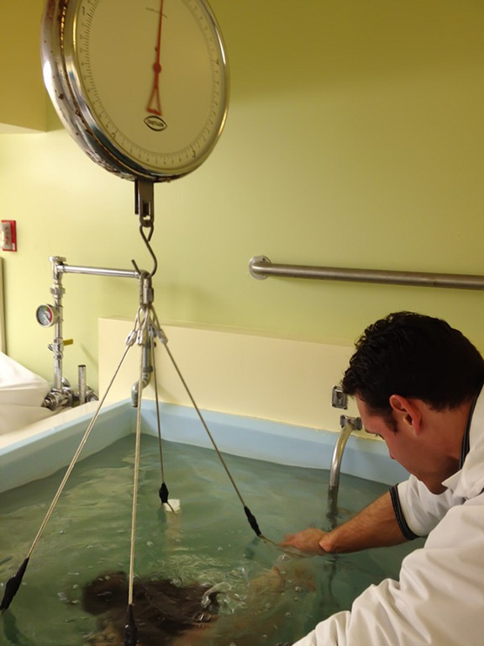
Hydrostatic Weighing
BV = { (BM-net UWW)/density of water }-
(RV +GV )
Db(Body density) = BM/BV
Db can be converted into
%body fat by using
appropriate equation.

Slide 29
Hydrostatic Weighing
Test retest reliability of hydro densitometry is reported excellent (r= 0.95)
SEE is approx ±2.5%

Slide 30
Hydrostatic Weighing
Limitation:
Procedure is time consuming.
Equipment is expensive, requires space and high maintenance.
Some clients may not perform the procedure.
Requires additional equipment to measure RV.

Slide 31
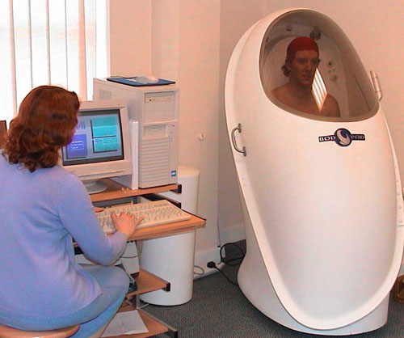
Air – Displacement Plethysmography
BOD POD system Consists of dual chambered
plethysmograph
Subject is tested in front chamber and instrumentation is housed in the rear chamber

Slide 32
Air – Displacement Plethysmography
Measures body volume by changes in air pressure within closed two compartment chamber.
Calculated density is put in Siri’s or Brozek equation.

Slide 33
Air – Displacement Plethysmography
System is user friendly, better client compliance, less technical skill required, faster and easier.
Test retest reliability of BOD POD system is reported (r = 0.96) for adult and lower in children (r = 0.90)
SEE is approx ± 2.2% to 3.7%.

Slide 34
Dual Energy X-ray Absorpsiometry
Is based on 3-C model
It is used to assess bone mineral content as well as regional estimates of bone, fat and lean tissues.
Uses low level radiation and is safe , fast and accurate.

Slide 35
Dual Energy X-ray Absorpsiometry
DXA is very reliable and valid in assessment of bone mineral content
Correlation coefficient of 0.99 with other techniques .Correlation with Hydrostatic weighing is 0.90
SEE is approx ±1.8% (more research required)

Slide 36
Dual Energy X-ray Absorpsiometry
Expensive and generally accessible in clinical or research settings.
Has more clinical utility than just body fat percentage.
DXA tables can hold a max weight of 136 kgs

Slide 37
Computed Tomography Scans (CT)
Magnetic Resonance Imaging Scans(MRI)

Slide 38
CT and MRI
Use a multicompartment model for body composition.
These imaging techniques quantify the volume of certain body tissues , such as fat through sequential slicing.
Relative analysis of muscle and bone density can be performed.

Slide 39
CT and MRI
Extremely useful in clinical settings and research.
Lack of statistical error data to compare with other methods.
Expensive technique and time consuming procedure makes it impractical.

Slide 40
Field Methods
Anthropometric Technique
Skinfold Technique
Bioelectrical Impedance Method

Slide 41
Anthropometric Technique
Body Mass Index
Waist Circumference
Waist-to-Hip Ratio

Slide 42
Body Mass Index
It is probably the most used assessment index of obesity.
BMI=Body weight (kg)/Height squared(m²).
SEE= ±5%,poor predictor of body fat percentage as it fails to distinguish between lean body mass and fat.

Slide 43
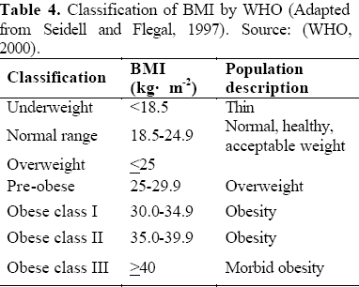
Body Mass Index

Slide 44
Waist Circumference (WC)
Is very strong predictor for abdominal obesity related diseases.
Is measured at the level midway between the lower rib margin and the iliac crest with the participant breathing out gently.

Slide 45
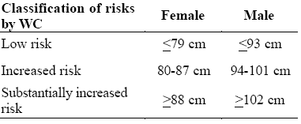
Waist Circumference (WC)

Slide 46
Waist-to-Hip Ratio (WHR)
It is ratio of the waist to hip circumference ratio
Waist is measured at the level midway between the lower rib margin and the iliac crest with the participant breathing out gently
Hip is measured as the maximum circumference over the buttocks

Slide 47
Waist-to-Hip Ratio (WHR)
Health risk increases with WHR and standards for risk vary with age and sex.
Eg; Health risk is very high for,
Young men >0.95 ; Young women >0.86
60-69 years old men: >1.03 & women >0.9
for same risk classification.

Slide 48
Skinfold Thickness Technique
Is used for calculating total body fat, by measuring thickness of subcutaneous fat.
Skin fold measurement is done under the assumption that 50% of subcutaneous fat is body fat.
SEE is approximately ±3.5%

Slide 49
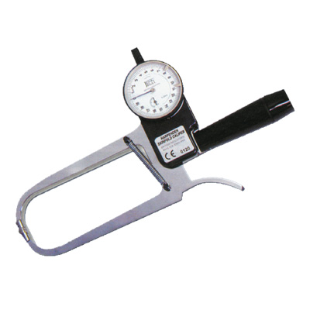
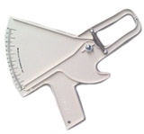
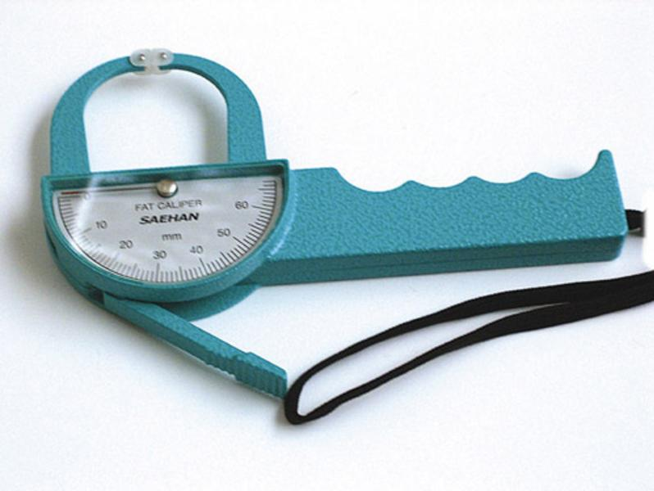
Harpenden
Slim guide
Lange

Slide 50
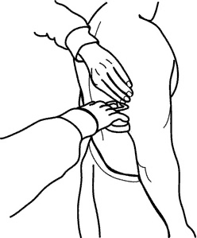
Triceps
Triceps : vertical fold taken mid way between acromion and olecranon processes while arm is relaxed and to the side of the body

Slide 51
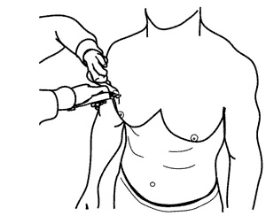
Chest
Chest : a diagonal fold measured midway between the anterior axillary line and nipple of men and one third the distance between the anterior axillary line and nipple for women

Slide 52
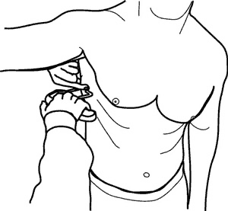
Midaxillary
Midaxillary : a vertical fold taken on the midaxillary line at the level of xiphoid process

Slide 53
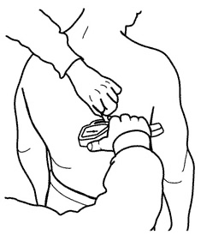
Sub scapular
Sub scapular : a diagonal fold of 1-2 cm below the inferior angle of scapula

Slide 54
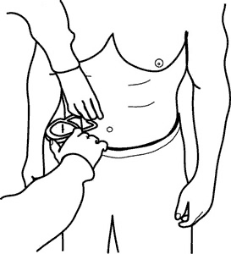
Abdominal
Abdominal : vertical fold measured 2cm right of umbilicus

Slide 55
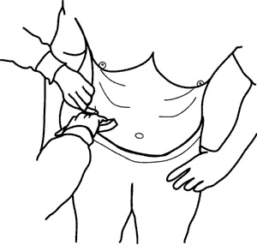
Suprailiac
Suprailiac : taken superiorly to the iliac crest in the anterior axillary line

Slide 56
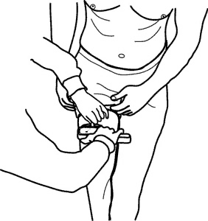
Thigh
Thigh : a vertical fold taken midway between the top of the patella and the inguinal crease on the anterior midline of the thigh

Slide 57
Equations
Men
Seven site
Db = 1.112 – 0.00043499(sum of 7SKF)+0.00000055
( sum of 7 SKF)² - 0.00028826(age)
Three site ( chest , triceps , subscapular)
Db=1.1125025– 0.0013125(sum of 3SKF)+0.0000055
(sum of 3 SKF)² - 0.000244(age)

Slide 58
Equations
Women
Seven site
Db=
1.097 – 0.00046971(sum of 7SKF)+0.00000056 ( sum of 7 SKF)² - 0.00012828(age)
Three site(triceps , suprailiac , abdominal)
Db=
1.089733 – 0.0009245 (sum of 3SKF)+0.0000025 ( sum of 3 SKF)² - 0.0000979(age)

Slide 59
Conversion of body density to body fat percentage.
% fat = 457/Body density -414.2
% fat =495/Body density-450

Slide 60
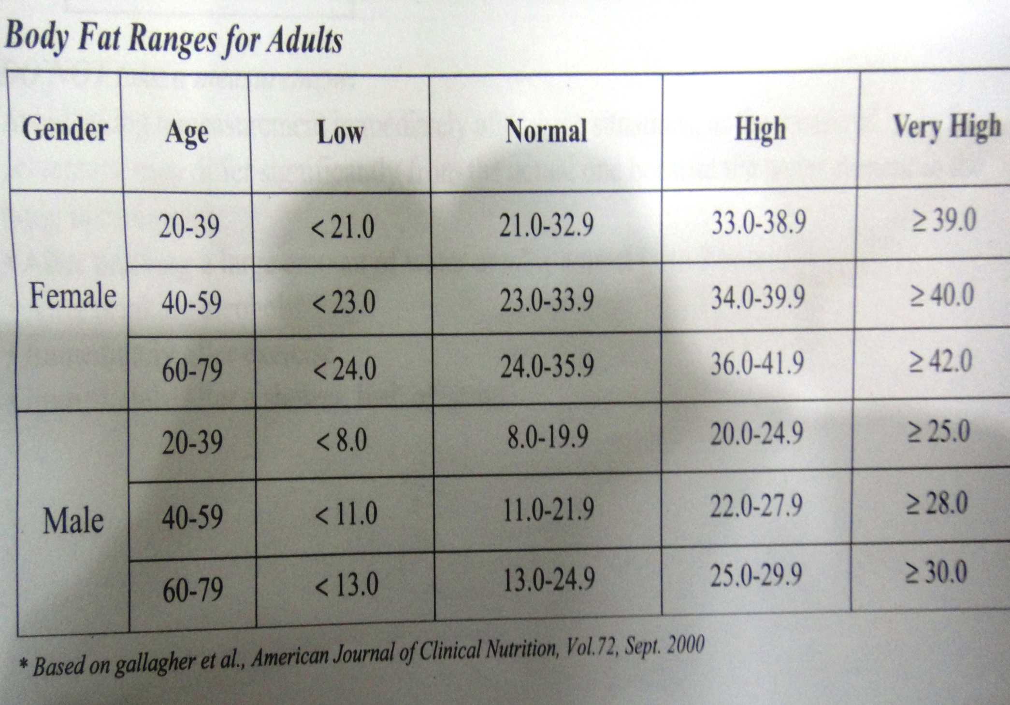

Slide 61
Bioelectrical Impedance Method
Based on 3-C model.
Principle: A small electrical current is passed into the body and than impedance to that current is measured.

Slide 62
Bioelectrical Impedance Method
Bioelectric impedance analysis (BIA) estimates body water based on this principle and uses equation for percent body fat based on 3-C model.
SEE is between 3.5%-5%.
Non invasive, easy to administer method.

Slide 63
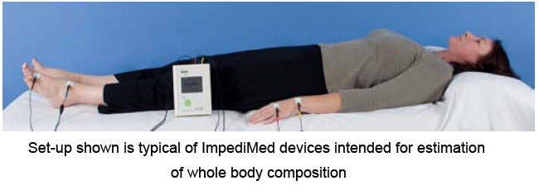
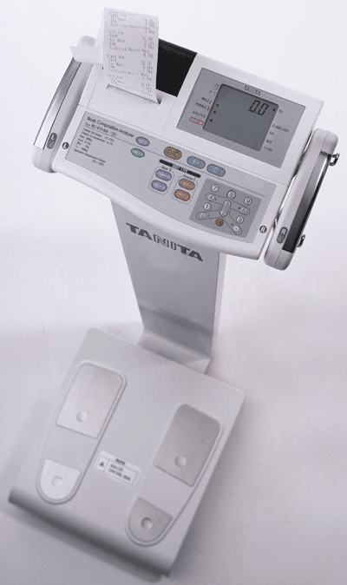
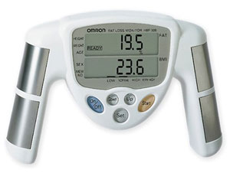
Bioelectrical Impedance Method

Slide 64
REFERENCES
ACSM’s Exercise Management for Persons with Chronic Diseases and Disabilities, 2nd Edition.
ACSM’s Recourse Manual for Guidelines for Exercise Testing and Prescription, 5th Edition.
ACSM’s for Guidelines for Exercise Testing and Prescription, 8th Edition.
Advanced Fitness Assessment and Exercise Prescription,5th Edition.
Salmi,Jukka A. Body composition Assessment with Segmental Multifrequency Bioimpedence Method. J Sports Sci & Med (2003),Supp 3 , 1-29.

Slide 65
Physical Fitness
Physical fitness is the ability to perform occupational, recreational and daily activities without becoming unduly fatigued.
Components
Cardiorespiratory endurance
Musculoskeletal fitness
Body weight and body composition
Flexibility

Slide 66
PHYSICAL FITNESS
“The ability to perform moderate to vigorous levels of physical activity without undue fatigue.”

Slide 67
Components of Physical fitness
Cardiorespiratory endurance: It is the ability of the heart, lungs and circulatory system to supply oxygen and nutrients to working muscles efficiently. Aerobic exercises are the effective way of improving Cardiorespiratory endurance.

Slide 68
Components of Physical fitness
Musculoskeletal fitness: It refers to the ability of the muscular and skeletal systems to perform work. Resistance training is one of the effective ways to improve the strength of muscles and bones and to develop muscular endurance

Slide 69
Components of Physical fitness
Body weight and body composition: Body weight refers to the size or mass of the individual.
Body composition views the Body weight in terms of the absolute and relative amounts of muscles, bone and fat tissues. Aerobic exercises and Resistance training are effective in altering the weight and composition.

Slide 70
Components of Physical fitness
Flexibility: Flexibility is the ability to move a joint or series of joints fluidly through the complete ROM. Daily stretching exercises can greatly improve flexibility.

Slide 71
Components of Physical fitness
Neuromuscular relaxation: It is the ability to reduce or eliminate unnecessary tension/stress or contraction in a muscle group. Progressive relaxation exercises and Tai Chi are examples of effective techniques for decreasing stress and Neuromuscular tension levels

Slide 72
Components of Physical Fitness
Flexibility
Endurance
Strength
Power
Speed
Agility
Body Composition
Coordination
Skill

Slide 73
Flexibility
The ability of the muscle to allow full range of movement in a joint
Tests of Flexibility :
Sit and Reach Test
Isolated muscle length tests

Slide 74
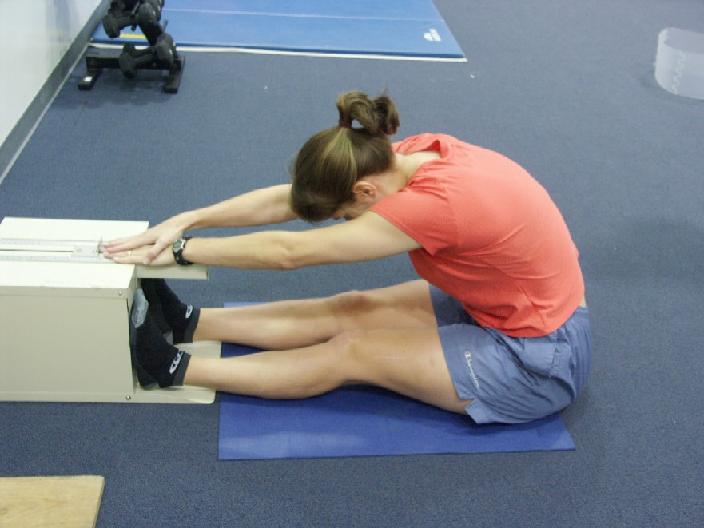
Sit and Reach Test
Requirements:
Sit and Reach box
Measuring Tape
Norms available

Slide 75
Muscular Strength
The amount of force a muscle can generate with a single maximum effort
Strength Tests
Maximum Bench Press Test
Maximum Leg Press Test
Hand Grip Strength

Slide 76
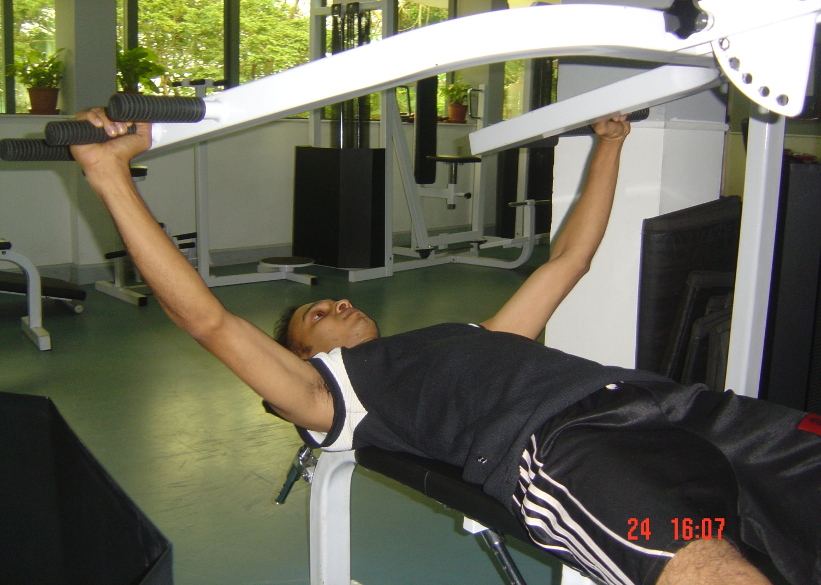
Maximum Bench Press Test

Slide 77
Maximum Bench Press Test
Equipment: Bench press machine
Barbell with assorted weights
Weighing Scale
Warm up with Low weights
Purpose: Find 1 RM
Result: 1RM (lbs) / Body weight (lbs)

Slide 78
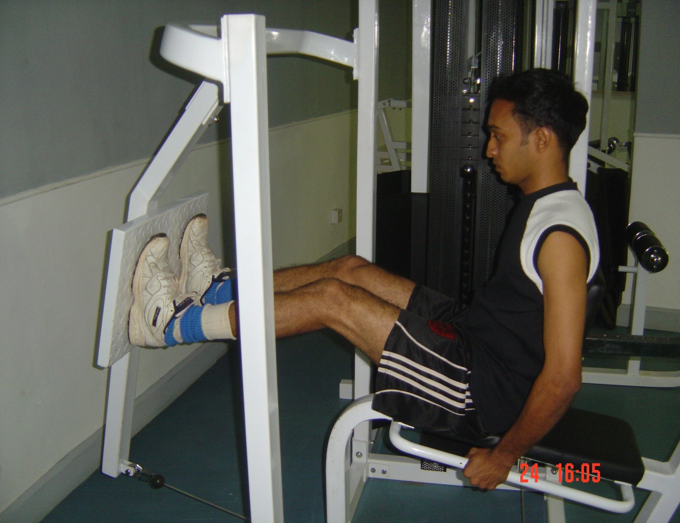
Maximum Leg Press Test

Slide 79
Maximum Leg Press Test
Equipments: Leg Press Machine Weighing Scale
Position of the Knee: 70 degrees
Purpose: To find 1 RM
Result: 1RM (lbs) / Body weight (lbs)

Slide 80
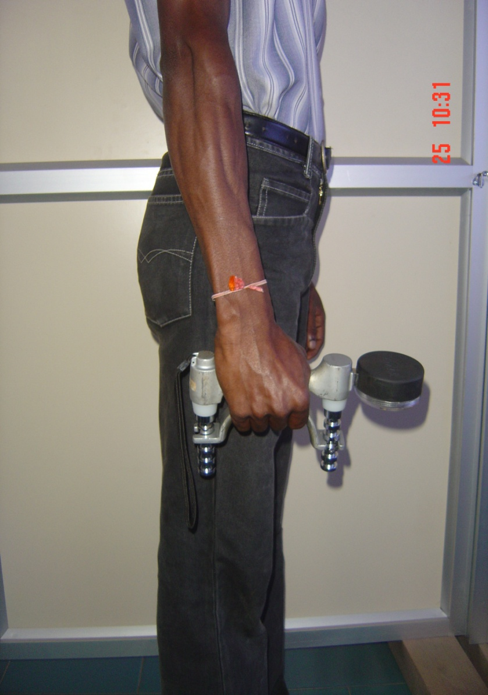
Hand Grip Strength Test

Slide 81
Hand Grip Strength Test
Equipment: Grip Strength Dynamometer
Adjust the Grip Size
Perform 3 trials with one minute rest
Tested bilaterally

Slide 82
Muscular Endurance
Ability of the muscle or group of muscles to contract repeatedly for a long period of time
Tests of Endurance
60 Second Sit up Test
The Curl Up Test
The Push Up Test
The Squat Test

Slide 83
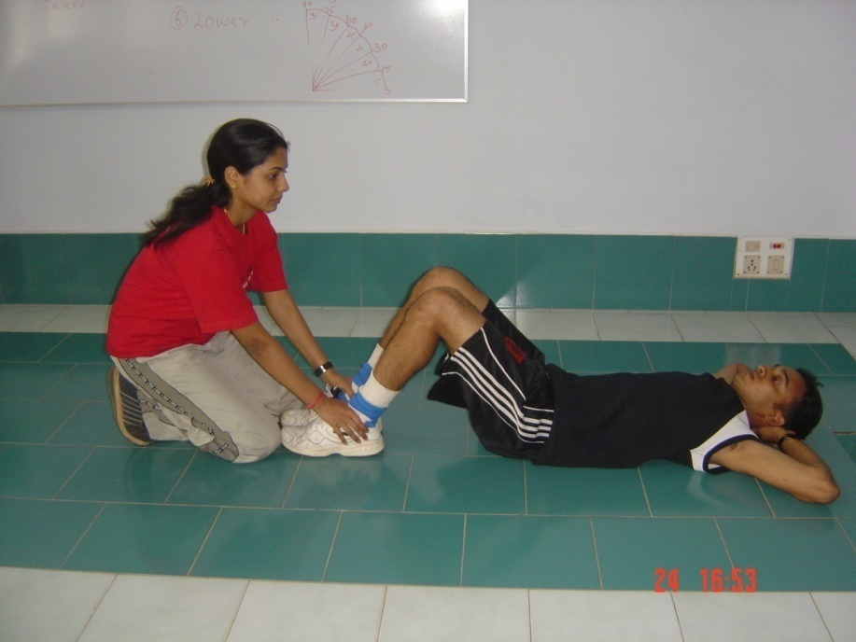
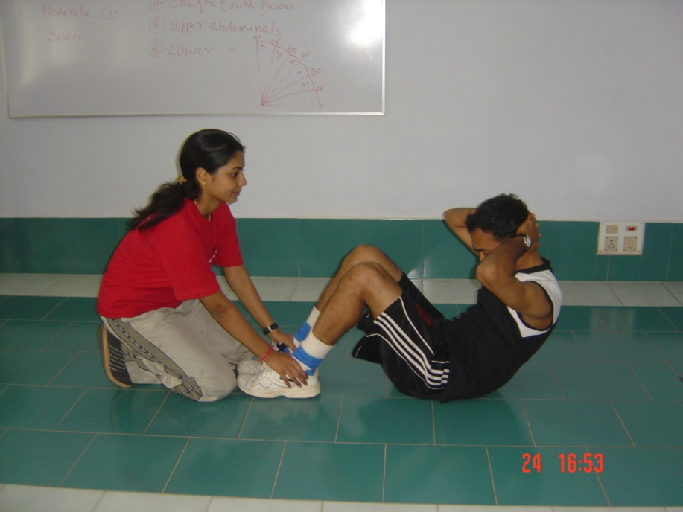
60 second Sit Up Test

Slide 84
60 second Sit Up Test
Requirements: Stop Watch
Partner to hold the ankle
Familiarize to proper technique
Instruction: To perform as many as possible
Norms available

Slide 85
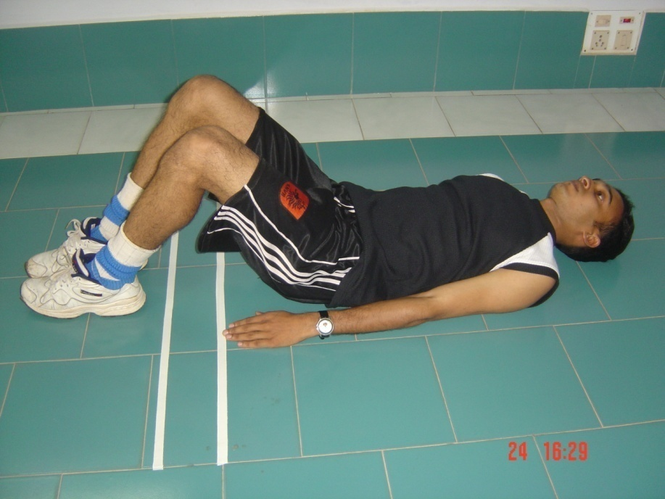
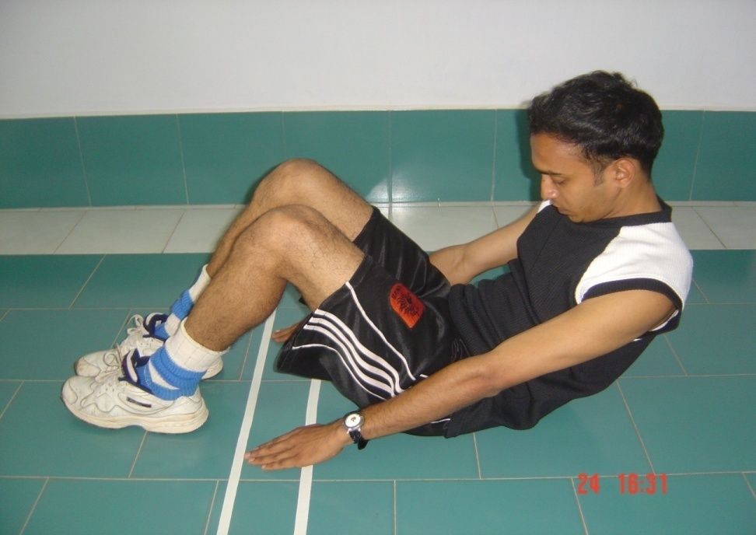
The Curl Up Test

Slide 86
The Curl Up Test
Equipment: Metronome
Adhesive Tape
Two strips placed 12 cms apart
Metronome paced at 40 bpm
Count number of curls

Slide 87
The Curl Up Test
Termination: No longer able to do
Not able to keep pace with metronome
Norms available

Slide 88
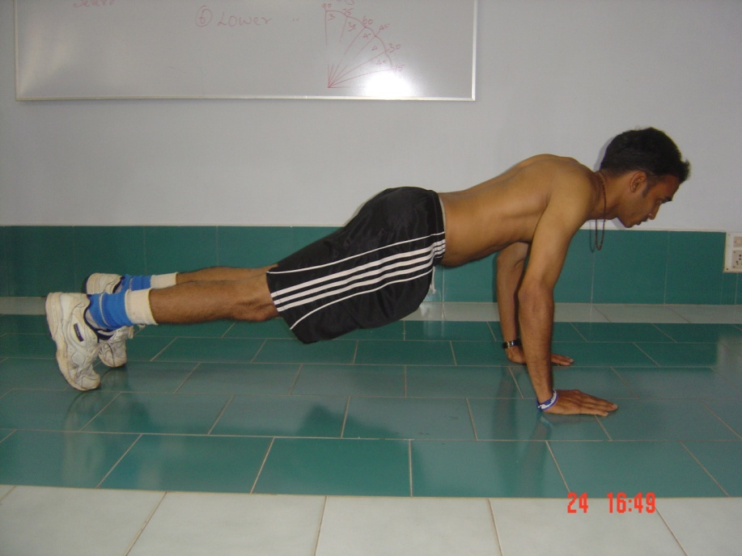
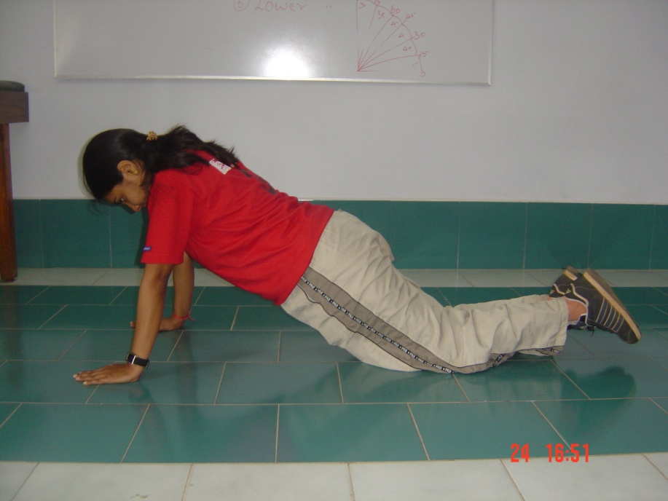
The Push Up Test

Slide 89
The Push Up Test
Familiarize the technique (modified Push up)
Instruction: Lower the chest with back held straight
Perform as many as Possible
Norms available

Slide 90
The Squat Test
Requirement: Appropriate Chair
Instruction: Squat down and lightly touch the chair
Perform as many as possible
Norms available

Slide 91
Muscular Power
Ability of the muscle to generate maximum force in the shortest time
Tests of Power
Vertical Jump Test (Sargeant Jump)
Standing Broad Jump
Medicine Ball Throws (3 kgs)

Slide 92
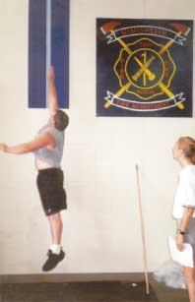
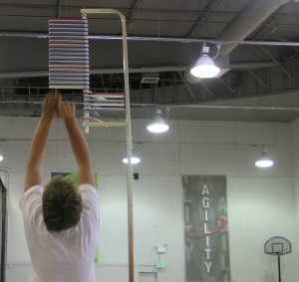
Vertical Jump Test

Slide 93
Vertical Jump Test
Measurement in the wall or device
Instruction: Jump as high as possible
Height measured in cms
Norms available
Modifications

Slide 94
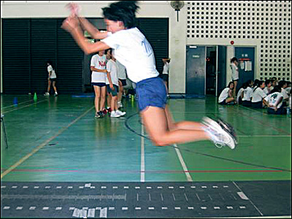
Standing Broad Jump

Slide 95
Standing Broad Jump
  Requirements: Measuring Tape
  Non-Slip Floor
  Technique: Two foot take off and landing
  Best of three trials
  Norms available

Slide 96
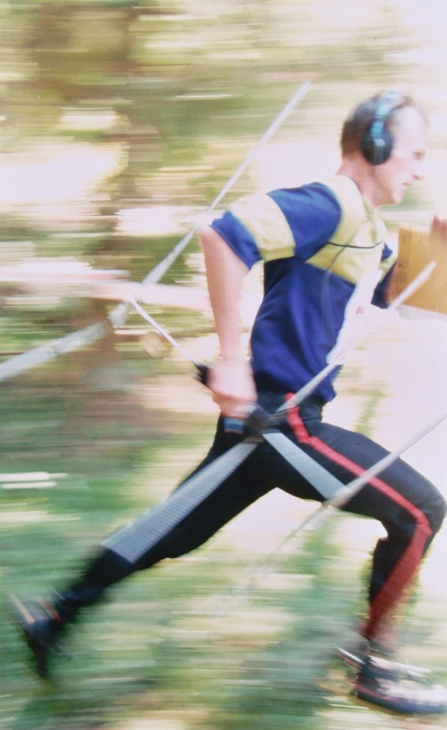
Speed
Rapidity with which successive
movement of the same kind can be
performed
Speed Test
To determine the maximum running speed
Requirements: Measuring Tape & Stop Watch
Adequate warm up and practice
Norms available

Slide 97
Agility
Ability to rapidly change the position of the entire body in space with speed and accuracy.
Agility Tests
Illinois Agility Test
505 Agility Test
Zigzag Test
T – Test
Hexagon Test

Slide 98
Illinois Agility Test
10 meters
5 Meters

Slide 99
Illinois Agility Test
Requirements: Flat non slip surface
Cones
Stop watch
Instruction to cover the course as quickly as possible
Norms available

Slide 100
505 Agility Test
Timing Gates
Start
10meters
5 meters

Slide 101
505 Agility Test
Requirements: Stop watch
Markers or cones
Non slip surface
Tests 180 degree turning ability
Turning ability to be checked on each leg
Norms unavailable

Slide 102
Zigzag Test
10 Feet
16 Feet

Slide 103
T Test
10
10 Meters

Slide 104
Hexagon Test
24 inches

Slide 105
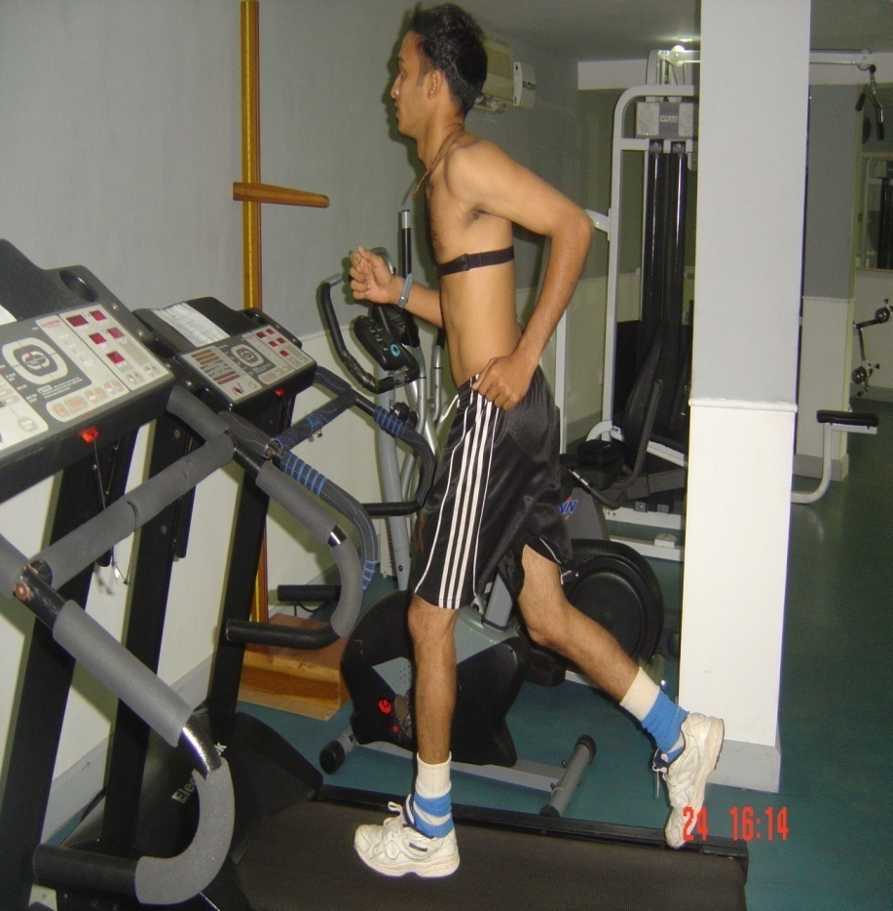
Cardio Respiratory Endurance
Ability of the Cardiovascular and the Pulmonary system to meet the physical demands placed while performing a prolonged dynamic, rhythmic exercise involving larger muscle groups

Slide 106
Tests of Cardio Respiratory Endurance
VO₂ Max
Maximal Tests: Gold standard of fitness testing
Submaximal Tests: Subjects are not taken to the maximal limits

Slide 107
Maximal Test
Requirements: Gas Analyzers (open/closed)
Heart Rate Tester, ECG
Ergometer
Protocols:
Varies from lab to lab
Continuous or interval
Test Duration – 5 to 15 Minutes

Slide 108
Sample Treadmill Protocol
Time | Speed for sedentary | Gradient | Speed for athletes | Gradient
1 | 3 Kph | 2% | 6 Kph | 2 %
2 | 4.5 Kph | 2 % | 9 Kph | 2 %
3 | 6 Kph | 2 % | 11 Kph | 2%
4 | 7.5 Kph | 2 % | 13 Kph | 2 %
5 | 9 Kph | 2 % | 15 Kph | 2%
6 | 9 Kph | 6 % | 17 Kph | 6 %
7 | 9 Kph | 10 % | 17 Kph | 10 %
8 | 9 Kph | 14 % | 17 Kph | 14 %

Slide 109
Specificity of VO₂ Max
VO₂ Max on a treadmill is considered maximum
VO₂ Max determined on Bicycle is reported to be 4 – 7% lower than Treadmill
VO₂ Max determined on Flume is reported to be 15% lower than Treadmill

Slide 110
Criteria for VO₂ Max
Plateau in VO₂
Reaching Age Predicted Maximal Heart Rate
VE / VO₂ in excess of 33
Blood Lactate exceeding 10 m.mol / liter
RER > 1.15

Slide 111
20 Meter incremental Shuttle Run Test
Requirements: Measuring tape, Cones
Non slip surface,
Pre recorded audio tape
Description: Initial speed 8.5 kmph
Increases by 0.5kmph every stage
Total of 23 Stages

Slide 112
20 Meter incremental Shuttle Run Test
Termination: No longer able to run or keep pace with the beats
VO₂ Max is calculated according to the stage of completion

Slide 113
Submaximal Tests
Conventional Treadmill Protocols
Astrand Rhyming Bicycle Ergometer Test
Cooper’s Test
Rockport Fitness Test
PWC ₁₇₀ Test
Step Tests

Slide 114
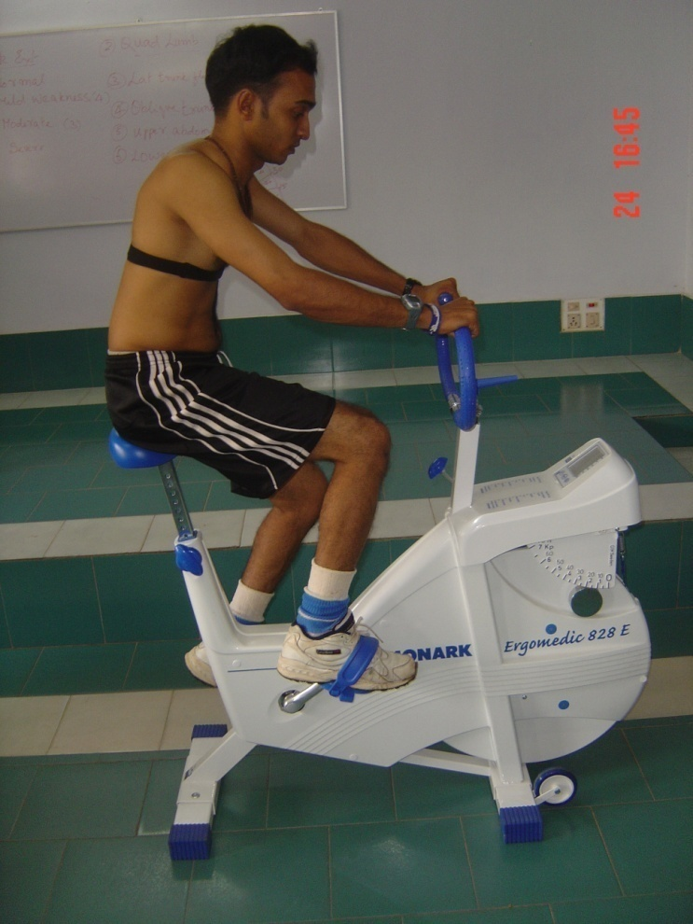
Astrand Rhyming Bicycle Ergometer Test
Requirements: Cycle Ergometer, HR Tester, Metronome,
Stop Watch
Familiarize pedaling on cycle
Adjust Seat Height
Select Workload (300, 600, 900 Kgm / min)

Slide 115
Astrand Rhyming Bicycle Ergometer Test
Pedal speed set at 50 Rpm
Workload maintained for 6 minutes
Workload should be sufficient to take the HR between 130 and 170
HR measured at the last 15-20 seconds of each minute

Slide 116
Astrand Rhyming Bicycle Ergometer Test
Termination: Difference in HR values of the 5th and 6th minute, less than 5bpm
Values spotted in the nomogram for VO2 max
Age Correction Factor
Age | 15 | 20 | 25 | 30 | 35 | 40 | 45 | 50 | 55 | 60 | 65
Factor | 1.10 | 1.05 | 1.0 | 0.94 | 0.87 | 0.83 | 0.78 | 0.75 | 0.71 | 0.68 | 0.65

Slide 117
Cooper’s Test
Requirements: Measured track
Stop watch, Measuring tape
Familiarize the concept of pacing
Instruction: Cover the longest possible distance
Record distance in miles
VO2 max = 35.97 X distance – 11.29

Slide 118
Rockport Fitness Test
Requirements: 1 Mile track, HR Tester, Stop watch
Instruction: To walk as fast as possible around the course
HR measured at the end of every quarter
Record time taken to complete
VO2 max = 6.9652 + 0.0091 X age + 0.5955 X sex – 0.2240 X T – 0.0115 X HR₄

Slide 119
PWC ₁₇₀ Test
Requirements: Cycle ergometer
HR Tester & Metronome
Two stage test paced at 60 Rpm
Stage 1: load = 1 Watt / kg.body weight
Stage 2: load = 2 Watt / kg.body weight
Duration : 2 minutes in each stages
Heart rate noted at the end of each stage

Slide 120
.
.
170

Slide 121
Is VO₂ Max the best indicator ???
Anaerobic Threshold
Measurement of Anaerobic Threshold
    Ventilatory Threshold
    Lactate Threshold

Slide 122
Tests of Anaerobic Energy Systems
Cunningham and Faulkner Test
Anaerobic Output Test

Slide 123
Cunningham and Faulkner Test
Requirements: Treadmill and Stop watch
Warm up at about 10kmph at 0 % inclination
Treadmill set at 12.9 kmph with 20%
Time starts when athlete start running unsupported and finishes when they grab rail
Max. Blood Lactate values may also be taken

Slide 124
Anaerobic Test
Requirements: Cycle Ergometer
HR Tester (optional)
Load: 6 Watts per kg body weight
Instruction: Cycle as fast as possible for the longest possible time

Slide 125
Anaerobic Test
Measurements:
Delay time: Time taken to reach 100 Rpm
Peak power: Maximum Rpm
Total time: Time when Rpm is maintained above 100
Anaerobic Index: Total time / Delay time

Slide 126
Choosing Tests
Establish motives
Specificity
Type of population
Screening for Neuro musculo Skeletal Dysfunctions

Slide 127
Training Methods
and
Principles

Slide 128
Pre requisites
Pre Participation screening
Comprehensive assessment of Fitness

Slide 129
Principles of Physical Training
Progressive overload
Specificity
Reversibility
Stress – Rest
Symmetry
Periodization

Slide 130
Periodization
Periodization of Annual Plan
Periodization of Biomotor abilities

Slide 131
Periodization
Phases | Preparatory |  | Competitive |  | Transition
Sub-phase | General preparation | Specific preparation | Pre- competitive | Competitive | Transition
Macro cycles
Micro cycles

Slide 132
Cardio Respiratory Endurance

Slide 133
Benefits of Cardio respiratory Endurance
Improved cardio respiratory function
Improved metabolism
Better control of Blood & body Fat levels
Protection against Diabetes and some types of cancer
Improved Psychological and Emotional well being
Improved Immune Function

Slide 134
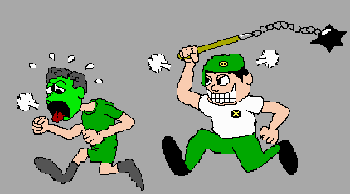
Training the Cardio respiratory Endurance
Type of activity:
Specific to the sport
Include variety
Methods of training:
continuous training
Interval training
Fartlek training

Slide 135
Training the Cardio respiratory Endurance
Frequency of training:
3 – 5 days per week
< 3days : No training benefits
> 5 days: Risk of injury and staleness

Slide 136
Training the Cardio respiratory Endurance
Intensity of training
50 – 85 % Heart Rate Reserve (ACSM)
THR Zone = RHR + % HRR
60 – 90 % Age predicted Maximal Heart Rate
RPE: 14 or 15 (somewhat hard or hard)

Slide 137
Training the Cardio respiratory Endurance
Duration of Training:
Depends on the Intensity
Exercise at THR Zone till you expend 4 Calories per kg body weight
Low or Moderate intensity: 45 – 60 minutes
High Intensity : 20 minutes

Slide 138
Percent contribution of Aerobic and Anaerobic systems to exercise based on time
 | 10 sec | 30 sec | 60 sec | 02 min | 04 min | 10 min | 30 min | 60 min | 120 min
Aerobic | 10 | 20 | 30 | 40 | 65 | 85 | 95 | 98 | 99
Anaerobic | 90 | 80 | 70 | 60 | 35 | 15 | 5 | 2 | 1

Slide 139
Training the Cardio respiratory Endurance
General Principles:
Warm up and Cool down
Lactate Threshold to be tapped everyday
Maintaining Cardio respiratory endurance

Slide 140
Muscular Strength and Endurance

Slide 141
Benefits of Muscular Strength and Endurance
Improved performance of physical activities
Injury prevention
Improved Body composition
Enhanced Self – Image
Improved musculoskeletal health with aging

Slide 142
Training Muscular Strength and Endurance
Selecting Equipments
Selecting the type of contraction
Selecting Exercises

Slide 143
Training Muscular Strength and Endurance
Load:
Heavy Load = 80 – 90% of 1RM
Medium Load = 50 – 80% of 1RM
Low Load = < 50% of 1 RM
Strength : Heavy load
Endurance : Low to medium (Acyclic & Cyclic)
General fitness : Higher medium (70%)

Slide 144
Training Muscular Strength and Endurance
Repetitions and Sets:
Low repetitions (Heavy weight) – Strength
(1 – 5 reps)
Higher repetitions (low weight) - Endurance
(20 – 25 reps) X 5 – 6sets
General fitness program – 8 to 12 Repetitions
( 3- 4 sets)

Slide 145
Training Muscular Strength and Endurance
Frequency of exercise:
2 – 4 days per week
Region wise workout
Muscle group wise workout

Slide 146
Flexibility

Slide 147
Benefits of Flexibility
Maintains Joint Health
Prevent Injuries
Decreased soreness associated with exercise
Improved body position for sports
Increases relaxation

Slide 148
Training Flexibility
Type of Stretch:
Intensity : Should feel mild discomfort
Frequency : 3 – 5 days per week
Duration : 10 – 30 Seconds

Slide 149
Physical Activity Rediness Questionnaire
PAR-Q
..\..\EIM_PAR_Q1.pdf

Slide 150
Screening For Health And Fitness In Childhood, Adulthood And Geriatric Group
Along with CR fitness, flexibility, and body composition, muscular fitness is recognized as an important component of health-related fitness in children and adolescents.
The benefits of enhancing muscular strength and muscular endurance in youth include developing proper posture, reducing the risk of injury, improving body composition, and enhancing motor performance skills such as sprinting and jumping

Slide 151
Assessing muscular strength and muscular endurance with the push-up and abdominal curl-up is common practice in most physical education programs,
When assessing muscular fitness in youth, it is important to avoid the “pass-fail” mentality that may discourage some boys and girls from participating.

Slide 152
Screening of Health and Fitness in Older Adutls
Assessing muscular strength, muscular endurance, and other aspects of health-related physical fitness in older adults can aid in detecting physical weaknesses and yield important information used to design exercise programs that improve strength before serious functional limitations occur.

Slide 153
30 seconds Chair Stand test
Purpose
To assess lower body strength needed for numerous tasks such as climbing stairs, walking, getting out of a chair, tub or car
Description
Number of full stands from seated postions that can be completed in 30 seconds with arms folded across chest

Slide 154
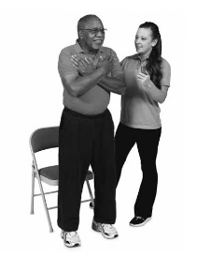
30 seconds Chair Stand test

Slide 155
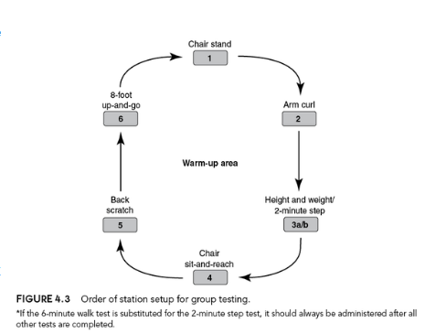

Slide 156
Other tests

